Slide 1

PDE For Barrier Options in C++
Final project 3
Group 3
John cai, xiaoyu liu, AARSH SACHDEVA, kuishuai yi
PDE For Barrier Options

Slide 2
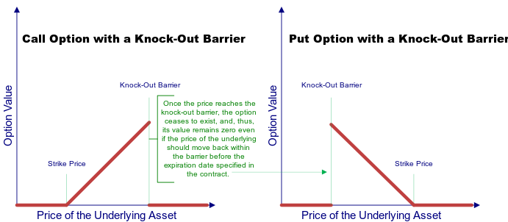
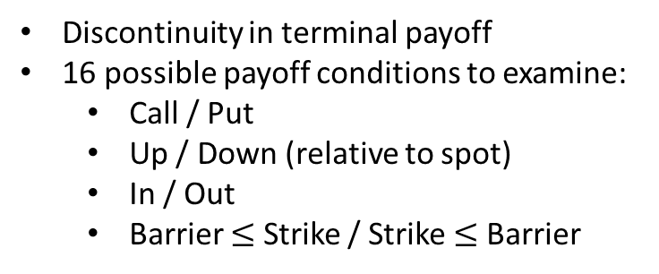
Introduction
Barrier Options
Code and Research Direction
Discontinuity in terminal payoff
16 possible payoff conditions to examine:
Call / Put
Up / Down (relative to spot)
In / Out
Barrier $≤$ Strike / Strike $≤$ Barrier
Coded 2 functions to price barrier options:
Exact pricer (continuous-time)
PDE pricer (discrete time)
3 Research Directions
Comparing the price of knock-out barriers using exact pricer vs PDE pricer
Convergence for one-year ATM UO barrier call (Crank Nicholson vs Fully-implicit)
Comparing PDE prices (all payoff conditions, beyond requirements) with BGK-adjusted prices
PDE For Barrier Options

Slide 3

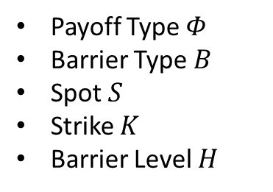



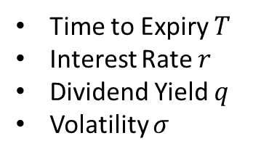
Code and Validations
Exact pricer: barrierOptionBS
PDE pricer: BarrBSPDE
Payoff Type $Φ$
Barrier Type $B$
Spot $S$
Strike $K$
Barrier Level $H$
Time to Expiry $T$
Interest Rate $r$
Dividend Yield $q$
Volatility $σ$
Additional inputs:
Monitoring Frequency:
Monthly, weekly, daily
Discount Curve: name of yield curve
Volatility:
$σ$
Volatility Term Structure
PDE Params
TimeSteps, Nodes, $θ$
Set Alignment $∈\left\{1,0\right\}$, ‘$1$’ to align with barrier, ‘$0$’ to align with spot
All Results $∈\left\{1,0\right\}$, ‘$0$’(default) returns price
Input validations
$Φ∈\{−1, 1\}$
$B∈\{UO,UI, DO, DI\}$
$S≥0$ (no arbitrage)
$K≥0$ (no arbitrage)
$H≥0$
For ‘Up’, $H≥S$
For ‘Down’, $H≤S$
$σ≥0$
$T≥0$ (haven’t expired)
PDE For Barrier Options

Slide 4
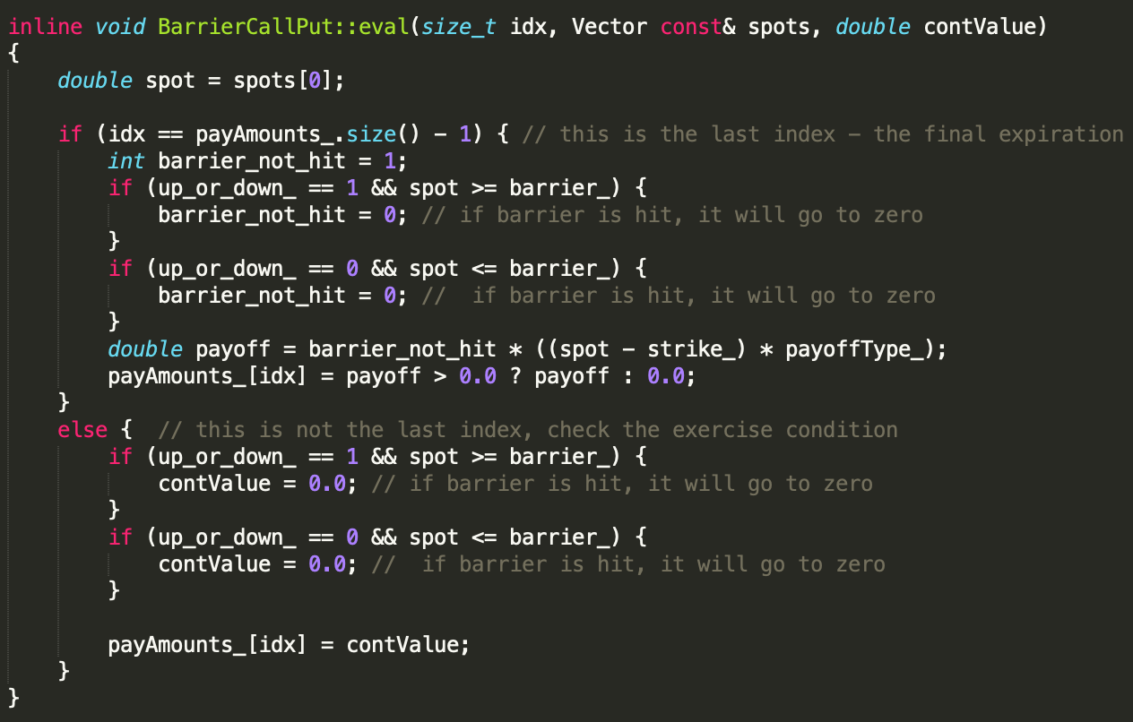
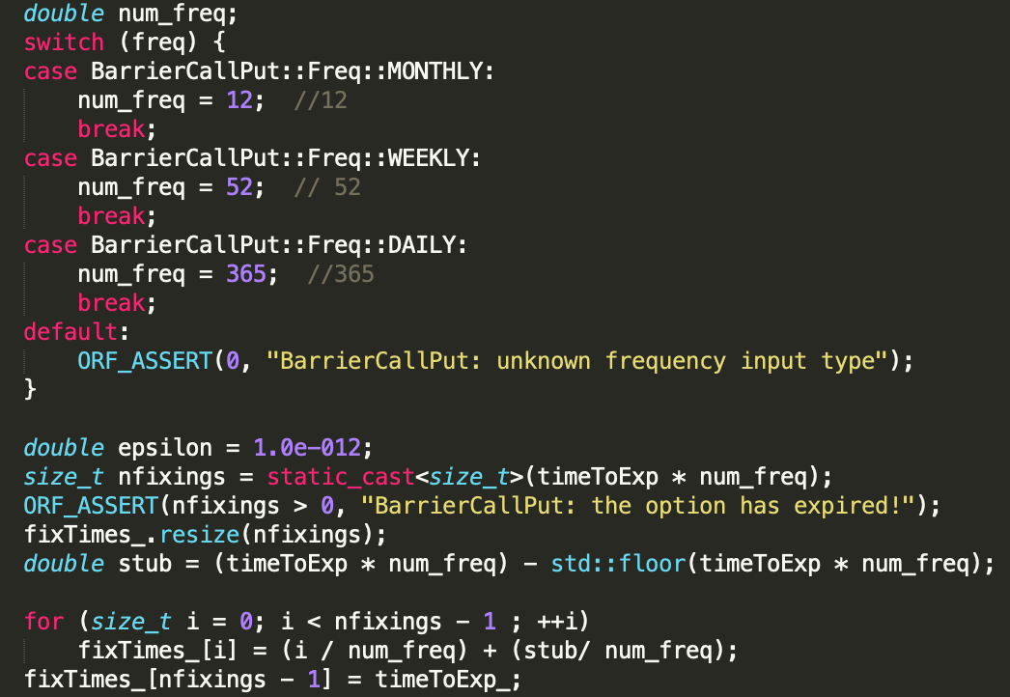
Code Implementation
At the last time step, evaluate the intrinsic value of the option for all price paths
At any previous time step, if the barrier is hit, set the continuation value of the path to 0.
Compute the stub and place the stub in the front
PDE For Barrier Options

Slide 5
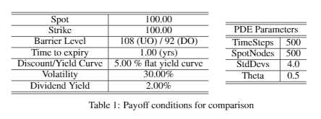
PDE vs. Closed Form Prices
Option prices decrease as monitoring frequency increases.
Down-and-Out Calls have a higher prices than Up-and-Out Calls, because the latter has capped upside potential. The converse relationship holds for Puts.
PDE For Barrier Options

Slide 6
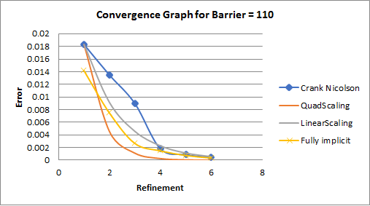
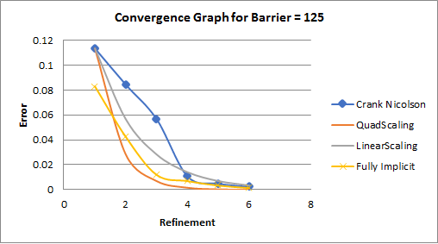
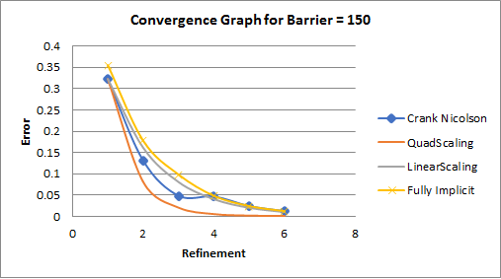
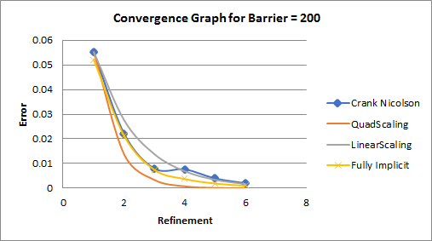
PDE Convergence
The convergence is in general closer to linear.
Crank-Nicholson exhibits certain level of oscillation at low refinement, whereas fully-implicit is smooth, agrees with literature [1]
Barrier option converges better when the barrier is further away from the spot.
=> This is is due to barrier’s discontinuity in the option payoff [2]
[1] Zvan et al. J. of Econ. Dyn. Control 24(11-12) 1563-1590, 2000
[2] Milev and Tagliani. Serdica Mathematical J. 36:75-88, 01, 2010
PDE For Barrier Options

Slide 7
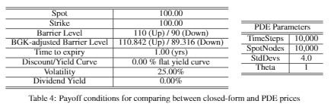
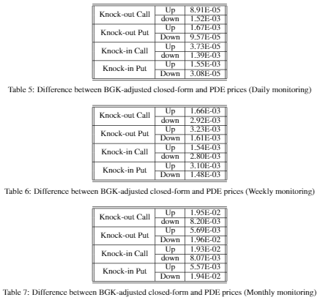
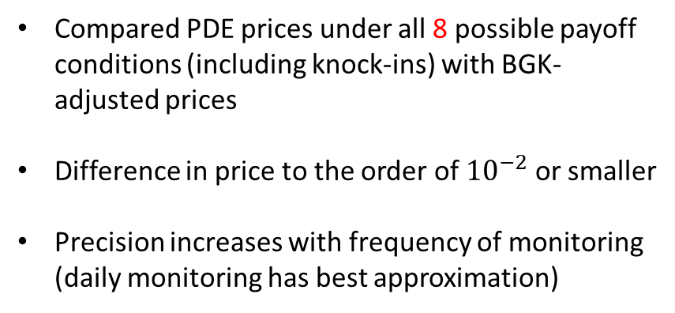
Applying BGK Adjustment
Compared PDE prices under all 8 possible payoff conditions (including knock-ins) with BGK-adjusted prices
Difference in price to the order of ${10}^{−2}$ or smaller
Precision increases with frequency of monitoring (daily monitoring has best approximation)
PDE For Barrier Options

Slide 8
Conclusion
Implemented exact pricer (continuous time) and PDE pricer (discrete time) functions
Exact prices vs PDE prices for Knock-out barriers:
Option Prices decrease as monitoring frequency increases
Crank Nicholson vs Fully-implicit convergence:
Convergence is close to linear
Fully-Implicit scheme has smoother convergence than Crank-Nicholson (agrees with Literature)
Convergence improves when barriers far away from spot
BGK-adjusted prices vs PDE prices
As monitoring frequency increases, precision increases, size of BGK-adjustment decreases
PDE For Barrier Options

